Slide 1

Implement Center Module für Learning Api -Software Engineering WS 18/19-
Lecturer: Damir Dobric
Professor: Prof. Dr. Andreas Pech
Student: Valerian Scherr (1101089)

Slide 2
Content
Methods
MNIST-Dataset of Handwritten Digits
Architecture
Implementation

Slide 3
Methods
Building the Average
→sum up all the values and divide them by the sum of number of values
Binarization of an array
→Build the average overall entries in the Array
→Every entry which is bigger than the average will be replaced with 1
→Every entry which is smaller will be replaced with 0

Slide 4
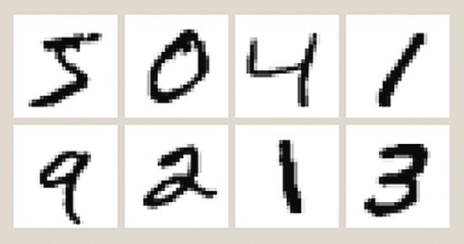
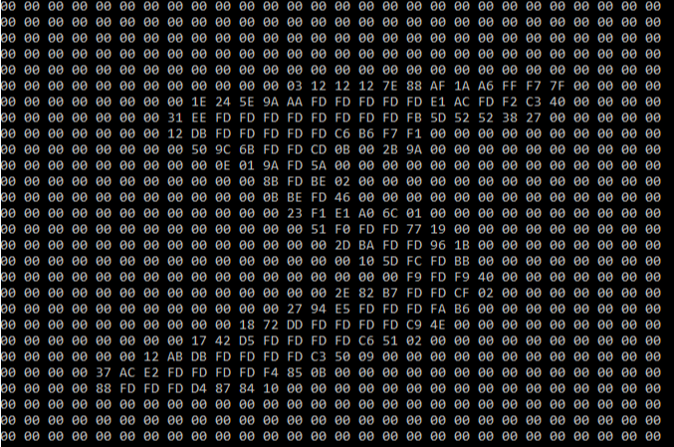
MNIST-Dataset of Handwritten Digits
-Big Dataset of Handwritten Digits from 0-9 ( over 60.000 Images)
-Dataset is used in the field of machine Learning
-Every Dataset consists of two files ( label and pixel)
-Size: 28x28 pixels
https://msdn.microsoft.com/de-de/magazine/dn745868.aspx

Slide 5
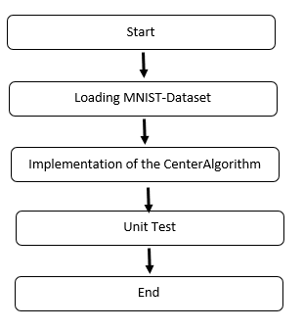
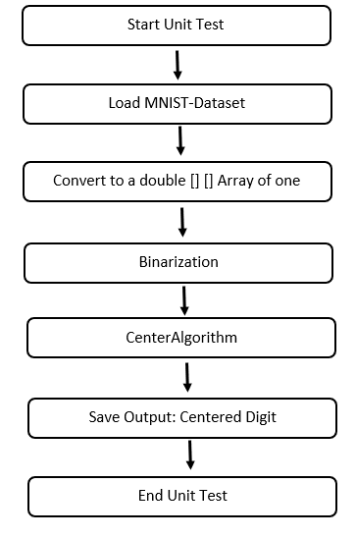
Architecture

Slide 6
Implementation
-Code explanation
-Present Unit-Tests

Slide 7
Thank you for you Attention!
Questions?

